Slide 1
Tkinter MODULE IN PYTHON
BY :
S.AFFRIN - 23BCS062
K.AKSHAYAASREE - 23BCS063
II CSE B 28.08.2024

Slide 2
What is Tkinter ?
Tkinter is a standard Python GUI library that provides a set of tools and widgets to create desktop applications with graphical interfaces.
Tkinter is the inbuilt python module that is used to create GUI applications.
The name “Tkinter” comes from “Tk interface”.
Tkinter provides a way to create windows, buttons, labels, text boxes, and other GUI components to build interactive applications.

Slide 3
Where is Python Tkinter used?
Creating windows and dialog boxes: Tkinter can be used to create windows and dialog boxes that allow users to interact with your program. These can be used to display information, gather input, or present options to the user.
Building a GUI for a desktop application: Tkinter can be used to create the interface for a desktop application, including buttons, menus, and other interactive elements.
Adding a GUI to a command-line program: Tkinter can be used to add a GUI to a command-line program, making it easier for users to interact with the program and input arguments.
Creating custom widgets: Tkinter includes a variety of built-in widgets, such as buttons, labels, and text boxes, but it also allows you to create your own custom widgets.

Slide 4
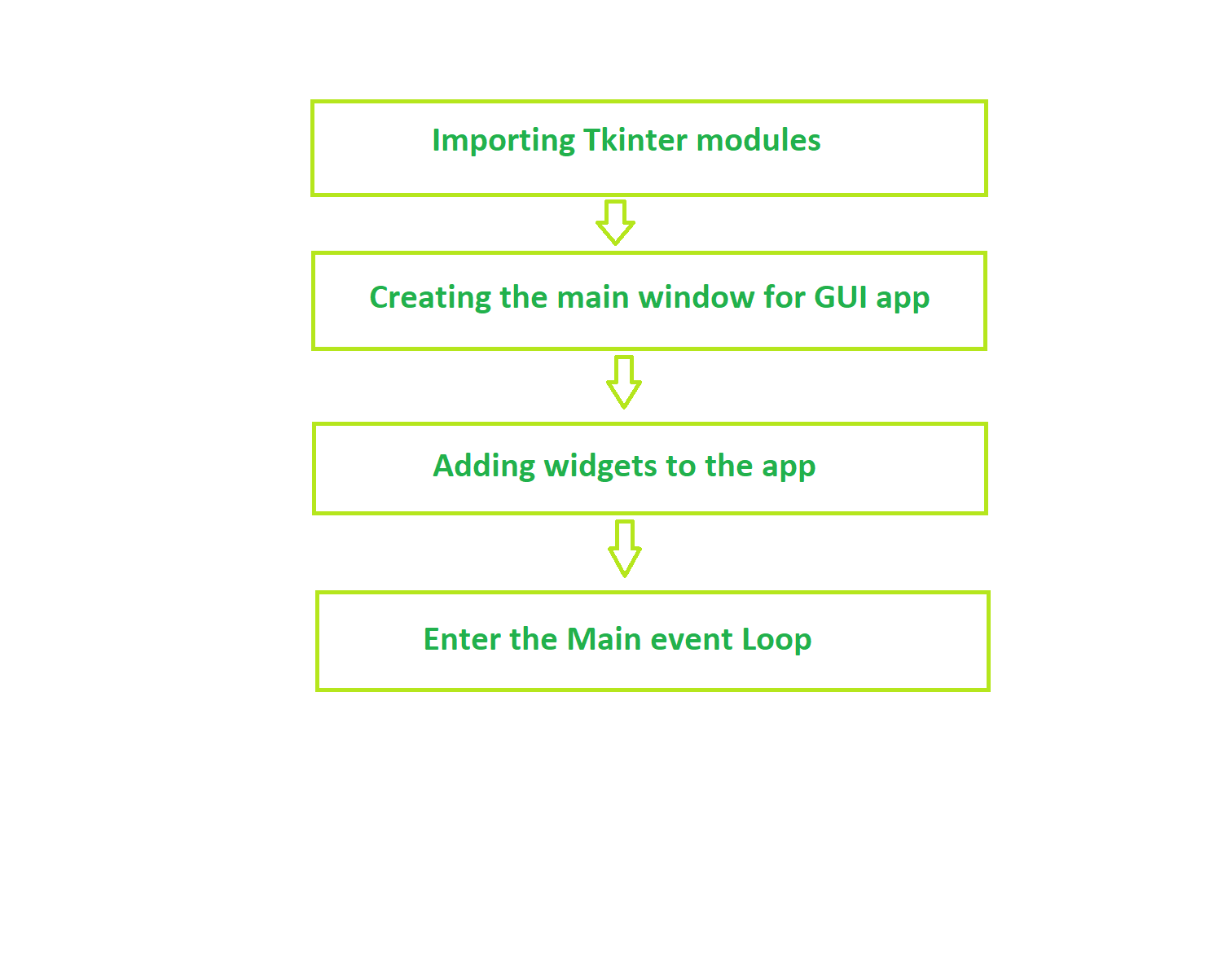
Fundamental structure of Tkinter program

Slide 5
Tk()
To create a main window, tkinter offers a method “Tk()”
SYNTAX : Tk(screenName=None, baseName=None,‘<classname>’, useTk=‘1’)
mainloop()
mainloop() is an infinite loop used to run the application, wait for an event to occur, and process the event as long as the window is not closed.
Pack()
the pack() method declares the position of widgets in relation to each other

Slide 6

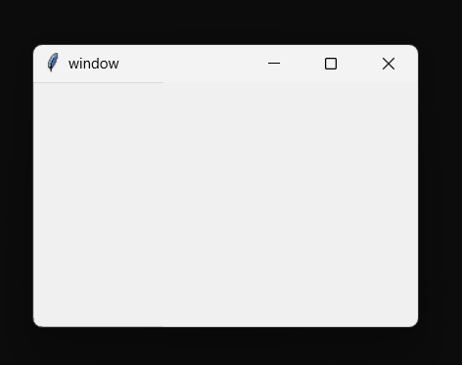
To create a Window

Slide 7
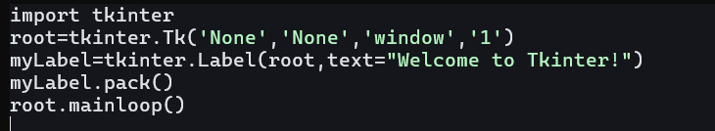
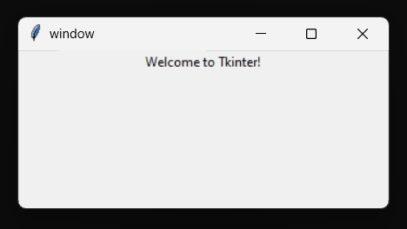
To add a Label
SYNTAX : myLabel = Label(root, text=“”)

Slide 8
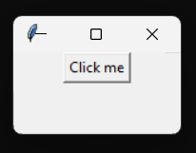
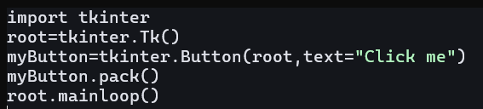
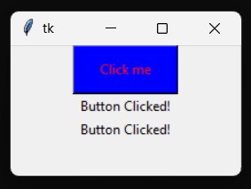
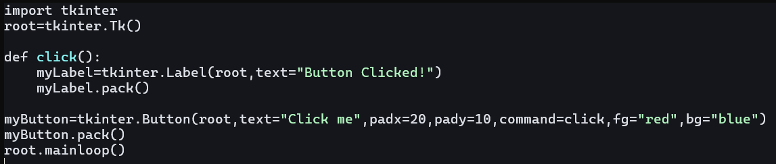
To add a Button
SYNTAX : myButton = Button(root, options)

Slide 9
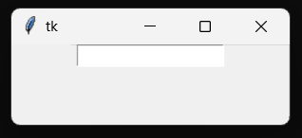
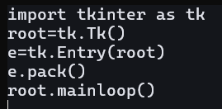
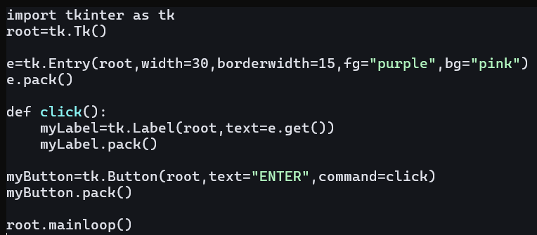
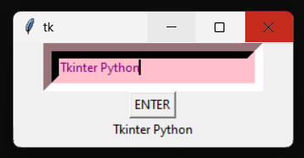
To create Input Fields
SYNTAX : e=Entry(root, options)

Slide 10
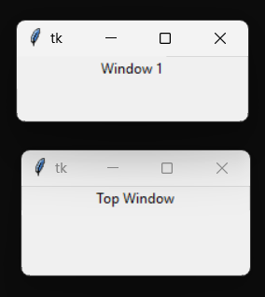
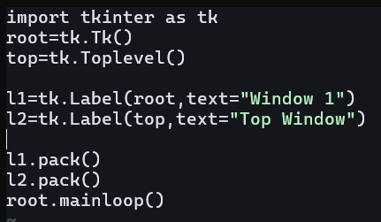
To create a New Window
SYNTAX : top = Toplevel()

Slide 11
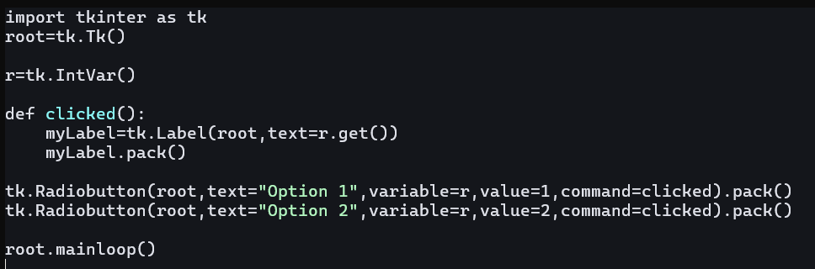
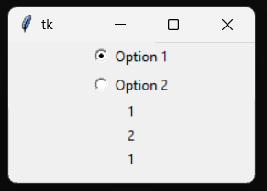
To add a Check Box
SYNTAX : Radiobutton(root, options)

Slide 12
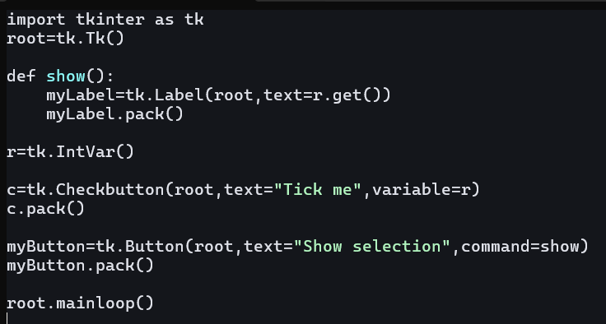
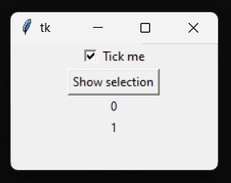
To add a Checkbox
SYNTAX : Checkbutton(root, options)

Slide 13
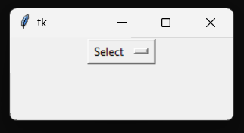
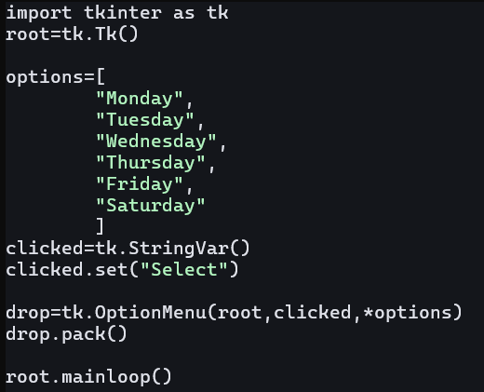
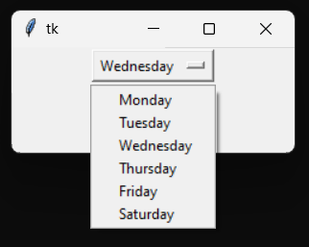
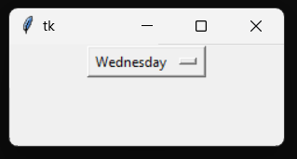
To create a Drop down Menu
SYNTAX : OptionMenu(root, Variable name, options)

